Slide 1
IFOAM – Organics International The global umbrella body for the whole organic sector. People 800 member organizations in 125 countries worldwide. .
Organic 3.0 and TIPI
The next phase for organic agriculture
Organic Agriculture Research Symposium
Asilomar, California, January 20, 2016
Andre Leu, President

Slide 2
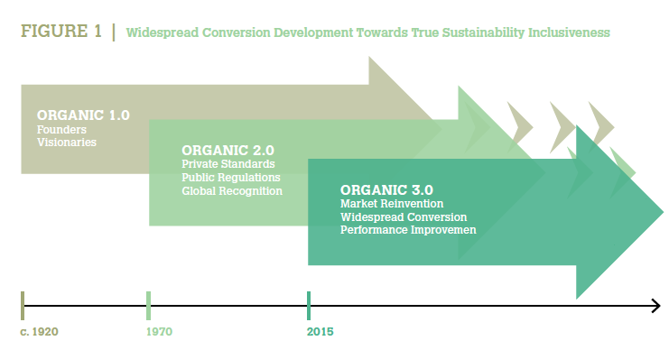
What is Organic 3.0?
This is the third phase of the global organic movement

Slide 3
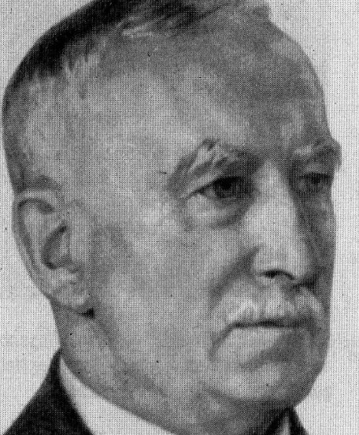
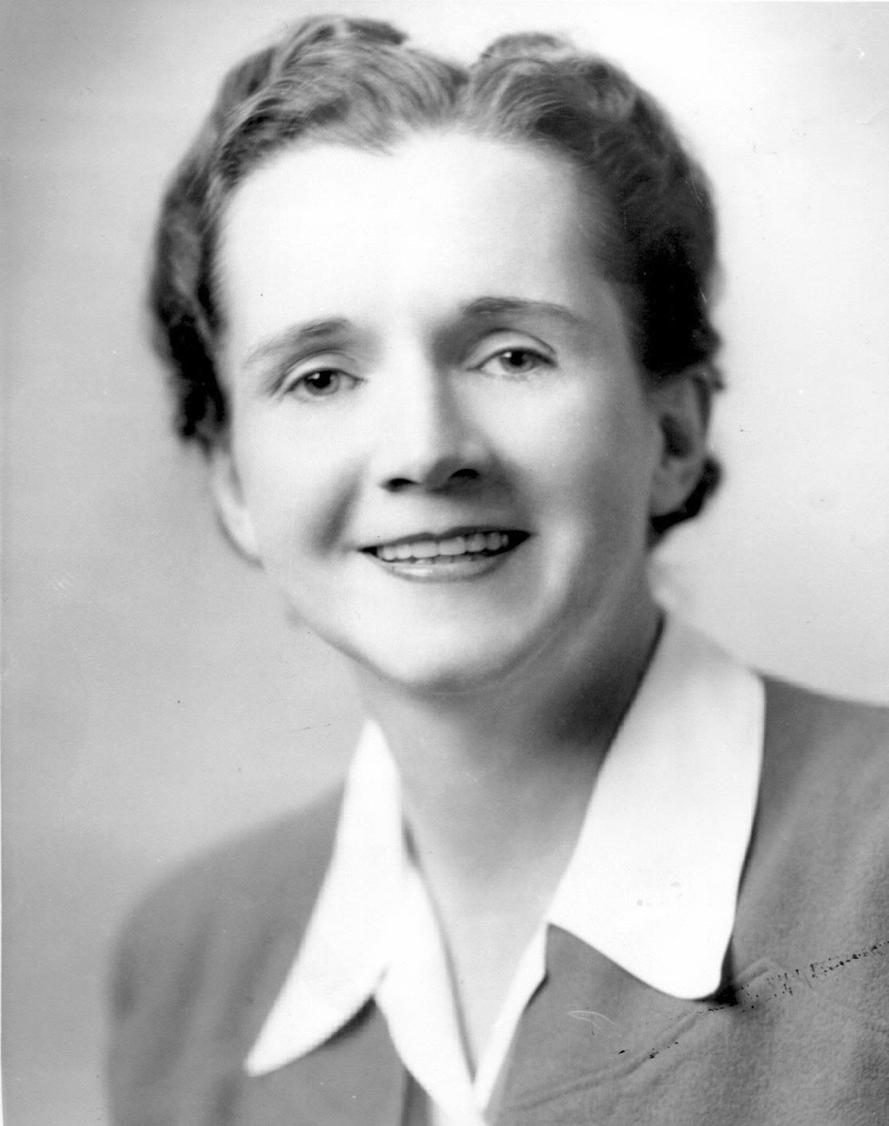
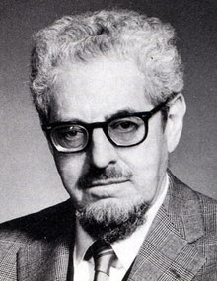
Organic 1.0
The first phase was initiated by our pioneers
Sir Albert Howard Lady Eve Balfour
Rachel Carson
J I Rodale
Examples of some of them
Rudolf Steiner

Slide 4
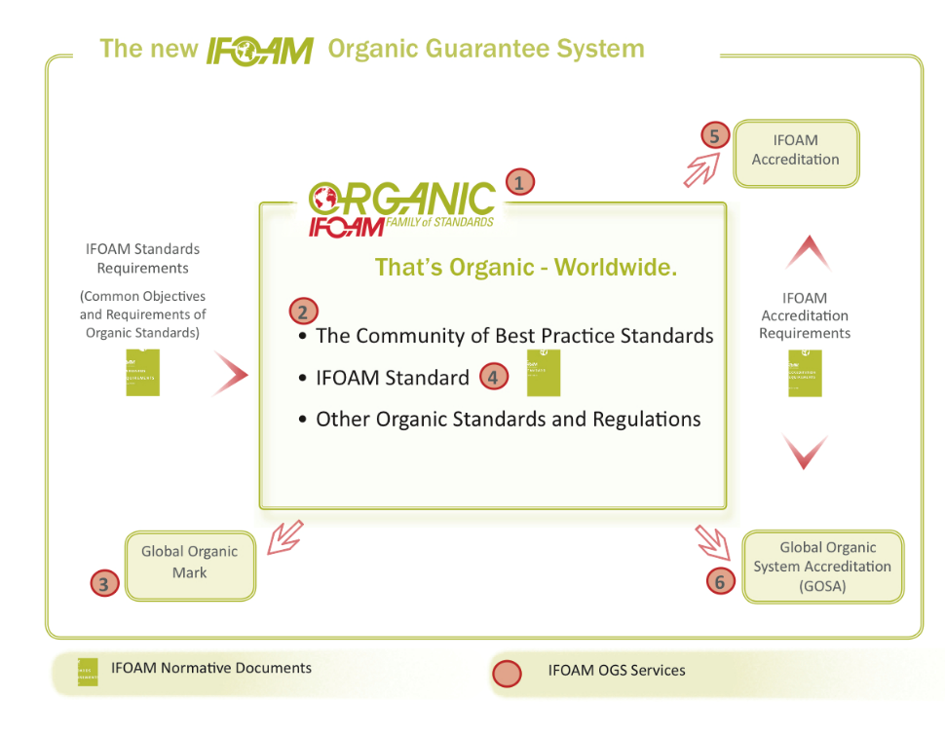
Organic 2.0
The second phase started in the 1970s and was defined by codifying organic agricultural systems
The introduction of standards and 3rd party certification systems along with government regulations
.

Slide 5
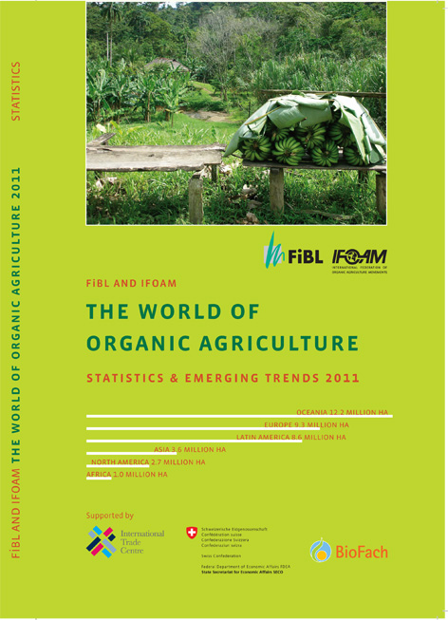
Organic 2.0
This saw the sustained growth of the current $72 billion sales in certified organic products.
IFOAM Organics International was a leader in this with our norms, such as the IFOAM Basic Standard which has been used as a reference document by many countries and organizations.

Slide 6
Organic 3.0
The strategy for Organic 3.0 includes six main features
A culture of innovation, to attract greater farmer adoption of organic practices and to increase yields.
Continuous improvement toward best practice, at a localized and regionalized level.
Diverse ways to ensure transparent integrity, to broaden the uptake of organic agriculture beyond third-party assurance and certification.

Slide 7
Organic 3.0
4. Inclusiveness of wider sustainability interests, through alliances with the many movements and organizations that have complementary approaches to truly sustainable food and farming.
5. Holistic empowerment from the farm to the final product, to acknowledge the interdependence and real partnerships along the value chain.
6. True value and fair pricing, to internalize costs, encourage transparency for consumers and policymakers and to empower farmers as full partners.

Slide 8
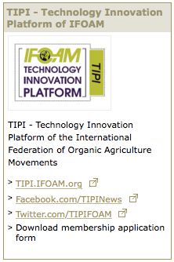

Slide 9
Membership is open to all stakeholders with an interest in advancing organic agriculture research. TIPI welcomes organizations and individuals to represent farmers, processors, traders, suppliers, consumers, scientists, state, foundations, individual donors and civil society. There is no fee to join at the present time.
TIPI

Slide 10
TIPI’s mission is: to engage and involve all stakeholders that benefit from organic agriculture research; to set a research agenda setting by a grassroots network approach; to foster international collaboration in organic agriculture research;

Slide 11
TIPI’s mission cont. to facilitate exchange of scientific knowledge of organic food and farming systems; and to help practitioners disseminate, apply and implement innovations and scientific knowledge consistent with the principles of organic agriculture. http://www.organic-research.net/tipi

Slide 12
“Regenerative organic agriculture improves the resources it uses, rather than destroying or depleting them. It is a holistic systems approach to agriculture that encourages continual on-farm innovation for environmental, social, economic and spiritual wellbeing.” Robert Rodale
Regenerative, Resilient, Relationship

Slide 13
Regenerative Organic Systems To define this: The paradigm shift away from a degenerative, industrial agriculture systems that are destroying our farmers and our communities income, health, biodiversity and climate to a regenerative agriculture based on the principles of health, ecology, fairness and care that rejuvenates the soil, water and biodiversity, our health, democracy, communities, prosperity, well being and reverses the processes contributing to catastrophic climate change.

Slide 14
Climate Change
Just adopting renewable energy and stopping emission will not stop climate change
If a boat is sinking we have to do more than just plug the leak – we have to bail out the water.
The world will reach 400 ppm CO₂ in 2016
This will mean 3.5 to 5 degrees warmer
4 degrees is regarded as catastrophic climate change
The target is 300 ppm to keep the world to less 1.5 degrees

Slide 15
Climate Change
Stopping emissions is not enough.
According to WMO Secretary-General Michel Jarraud
“Carbon dioxide remains in the atmosphere for hundreds of years and in the ocean for even longer. Past, present and future emissions will have a cumulative impact on both global warming and ocean acidification. The laws of physics are non-negotiable,”
We need to draw the excess CO₂ out of the atmosphere
350 ppm means 2 degrees of warming
Global sea levels rises that cause the atoll island countries to disappear, cause large parts of Bangladesh, coastal USA, New York, New Orleans, London and other low lying areas to go under water, causing a huge refugee crisis for millions of people
It will mean increased frequency and severity of droughts, floods and storms causing food shortages and more humanitarian crises
1 in 30 years events now occur in 1 in 5 year cycles

Slide 16
Climate Change
The worldwide adoption of Regenerative Organic Agriculture can reverse climate change
Means that we could reduce temperatures to pre industrial levels (1750s) and avoid 2 degrees in warming.
Need to reduce CO₂ levels by 122 ppm to reach pre industrial temps of the 1800s - From 400 ppm to 278 ppm – not just 350 ppm

Slide 17
Mitigation of Carbon Dioxide
Soils are the greatest carbon sink after the oceans
Over 2700 Gt of carbon is stored in soils worldwide
Biomass 575 Gt most of which is wood. Source (Lal 2008)
Atmosphere 848 Gt
1 Gt (gigaton) = 1 billion metric tons
I metric ton = 1.10231 US ton
Reducing CO₂ levels by 122 ppm = 946.72 gt of CO₂
It would be most logical to remove the 946.72 gt of CO₂ from the atmosphere and put it as 258.64 gt of carbon into the soil – where it is needed

Slide 18
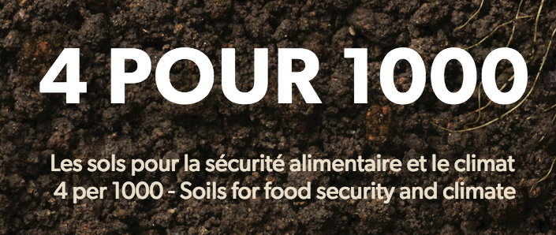
What does « 4 per 1000 » mean?
An annual growth rate 4 parts per thousand of the soil carbon stock would make it possible to stop the present increase in atmospheric CO2.
The UNFCC recognizes this initiative by French Government as part of the Lima – Paris accord.
Many Countries, regions, FAO,IFAD, GEF, CGIAR and numerous NGOS have signed on.

Slide 19
Soil Carbon Sequestration
Agriculture, Ecosystems & Environment Journal study:
24 comparison trials from Mediterranean Climates in Europe, the USA and Australia. organic systems sequestered 3559.9 kg of CO2/ha/yr. (Aguilera et al., 2013)
Kg/ha = lbs/acre
The Rodale FST manured organic plots sequestered 3,596.6 kg of CO2/ha/yr.
Sekem, Egypt, has sequestered 3,303 kgs of CO₂ per hectare per year
If extrapolated globally, good organic practices can sequester around 17 Gt per year
It would take 57 years to remove the 946.72 gt of CO₂ and reverse climate change

Slide 20
Soil Carbon Sequestration
The Rodale Compost Utilization Trial sequestered 8,220.8 kg of CO2/ha/yr.
(Total Agricultural Land 4,883,697,000 ha x 8,220.8 kg of CO2/ha/yr)
If extrapolated globally would sequester 40 Gt of CO₂.
It would take 24 years to remove the 946.72 gt of CO₂ and reverse climate change

Slide 21
Regenerative Grazing
‘In a region of extensive soil degradation in the southeastern United States, we evaluated soil C accumulation for 3 years across a 7-year chronosequence of three farms converted to management-intensive grazing.
Here we show that these farms accumulated C at 8.0 Mg ha−1 yr−1, increasing cation exchange and water holding capacity by 95% and 34%, respectively.’ (Machmuller et al. 2015)
If these regenerative grazing practices were implemented on the world’s grazing lands they would sequester 98.5 gt CO₂/yr.
(Grasslands: 3,356,940,000 ha x 29.36 = 98.5 gt CO₂/yr)
It would take 10 years to remove the 946.72 gt of CO₂ and reverse climate change

Slide 22
Soil Organic Matter and Nitrogen
Synthetic Nitrogen Fertilizers Deplete Carbon
Scientists from the University of Illinois analyzed the results of a 50 year agricultural trial and found that synthetic nitrogen fertilizer resulted in all the carbon residues from the crop disappearing as well as an average loss of around 10,000 kg of soil carbon per hectare.
Kg/ha = lbs/acre
This is around 36,700 kg of carbon dioxide per hectare on top of the many thousands of kilograms of crop residue that is converted into CO₂ every year.

Slide 23
Soil Organic Matter and Nitrogen
Synthetic Nitrogen Fertilizers Deplete Carbon
The researchers found that the higher the application of synthetic nitrogen fertilizer the greater the amount of soil carbon lost as CO₂ and soil nitrogen as N₂O – two major GHG gases
This is one of the major reasons why conventional agricultural systems have a decline in soil carbon while organic systems increase soil carbon
Khan, S. A.; Mulvaney, R. L.; Ellsworth, T. R., and Boast C. W. (2007), The Myth of Nitrogen Fertilization for Soil Carbon Sequestration. Journal of Environmental Quality. 2007 Oct 24; 36(6):1821-1832.
Mulvaney R. L., Khan S. A. and Ellsworth T. R., (2009), Synthetic Nitrogen Fertilizers Deplete Soil Nitrogen: A Global Dilemma for Sustainable Cereal Production, Journal of Environmental Quality 38:2295-2314 (2009): 10.2134/jeq2008.0527, American Society of Agronomy, Crop Science Society of America, and Soil Science Society of America 677 S. Segoe Rd., Madison, WI 53711 USA

Slide 24
Soil Organic Matter and Nitrogen
Soil Organic Matter Increases Soil Nitrogen
Soil organic matter (SOM) contains nitrogen expressed in a Carbon to Nitrogen Ratio. This is usually between 11:1 to 9:1, however there can be further variations.
Accepted approximation ratio for the amount of soil organic carbon in soil organic matter. This is SOC × 1.72 = SOM.
Average ‘… a 1% increase in organic carbon in the top 20 cm [8 inches] of soil represents a 24 t/ha [24,000 kilograms] increase in soil OC…’ (Jones 2006)

Slide 25
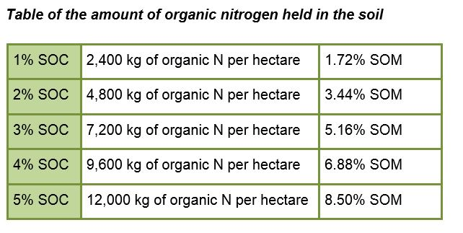
Organic Matter and N
The key to high levels of N is high levels of organic matter (kg/ha =lbs/acre)

Slide 26
Climate Resilience
Food Security
World food production is already being effected by climate change
More frequent and longer droughts
Irregular rainfall that tends to be heavy and destructive
Increases in climate extremes
1 in 30 years events now occur in 1 in 5 year cycles
Supplying adequate food is vital

Slide 27
Organic Adaptation &
High Yields
Organic Higher Yields in Climate Extremes
Organic systems have higher yields than conventional farming systems in weather extremes such as heavy rains and droughts. (Drinkwater, Wagoner and Sarrantonio 1998; Welsh, 1999; Lotter 2004)
The Wisconsin Integrated Cropping Systems Trials found that organic yields were higher in drought years and the same as conventional in normal weather years. (Posner et al. 2008)
The Rodale FST showed that the organic systems produced 30 per cent more corn than the conventional system in drought years. (Pimentel D 2005, La Salle and Hepperly 2008)
Notes:
FiBL
2/26/16
www.fibl.org
27

Slide 28
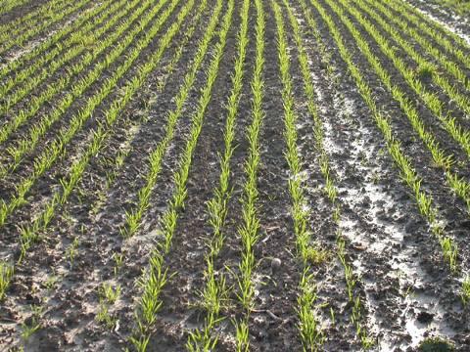
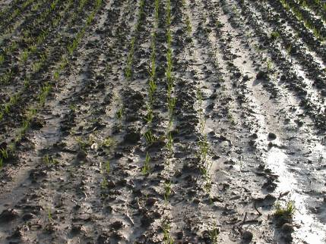
Organic Matter Increases Infiltration and Soil Stability
Organic 3.0 Systems
Organic
Conventional
Picture: FiBL DOK Trials

Slide 29
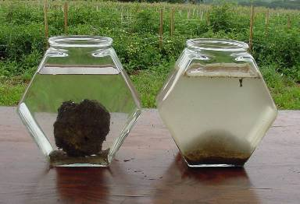
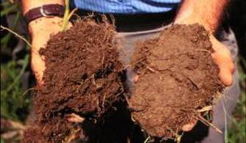
Soil Organic Carbon Mitigates and Adapts
Higher corn and soybean yields in drought years
Increased soil C and N
Higher water infiltration
Higher water holding cap
Higher microbial activity
Increased stability

Slide 30
Soil Organic Matter Living Carbon
Holds up to 30X its weight in water
Cements soil particles and reduces soil erosion
Increases nutrient storage & availability
Humus can last 2000 years in the soil
Electron micrograph of
soil humus

Slide 31
Improved Efficiency of Water Use
Research Shows that Regenerative Systems use Water More Efficiently
Volume of Water Retained per Acre (to 12 inches) in relation to soil organic matter (SOM)
1 % SOM = 16,640 (common level Africa, Asia, Aust)
2 % SOM = 33,280 Gallons
3 % SOM = 49,920 Gallons
4 % SOM = 66,560 Gallons (levels pre farming)
5 % SOM = 83,200 Gallons (levels pre farming)
6 % SOM = 99,840 Gallons (levels pre farming)
Adapted from Morris, 2004.

Slide 32
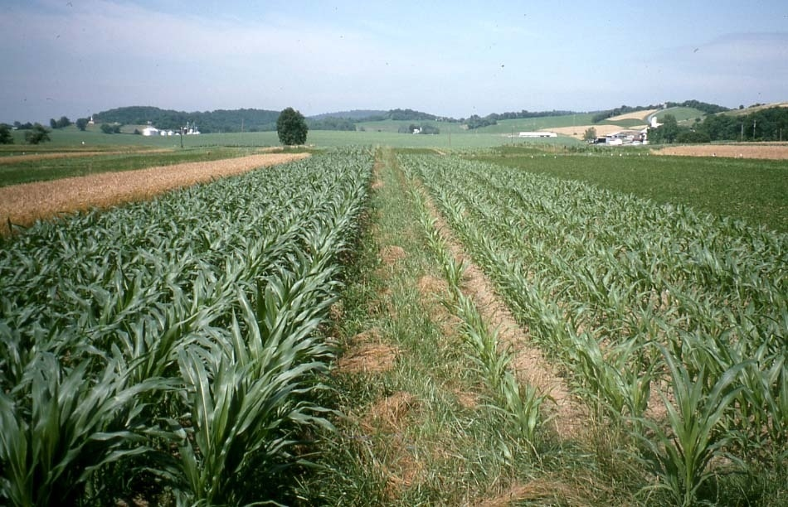
Organic Corn - 1995 Drought
Better infiltration, retention, and delivery to plants helps avoid drought damage
Organic
Conventional
Picture: Rodale Institute

Slide 33
High Yield Regenerative Organic Agriculture
The average corn yields during the drought years were from 28% to 34% higher in the two organic systems.
The yields were 6,938 and 7,235 kg per ha in the organic animal and the organic legume systems, respectively, compared with 5,333 kg per ha in the conventional system (Pimentel et al. 2005)
Lbs per Acre = Kg per ha (close enough)

Slide 34
High Yield Regenerative Organic Agriculture
The Wisconsin Integrated Cropping Systems Trials
Organic yields were higher in drought years, the same as conventional in normal weather years and lower in very wet years. (Posner et al 2008)
Flame and steam weeding, acetic acid?

Slide 35
High Yield Regenerative Organic Agriculture
Iowa State University Long Term Agroecological Research
organic corn harvests averaged 130 bushels per acre while conventional corn yield was 112 bushels per acre
organic soybean yield was 45 bu/ac compared to the conventional yield of 40 bu/ac in the fourth year (Delate, 2010).
Washington State University Study
compared the economic and environmental sustainability of conventional, organic and integrated growing systems in apple production and found similar yields (Reganold et al., 2001).

Slide 36
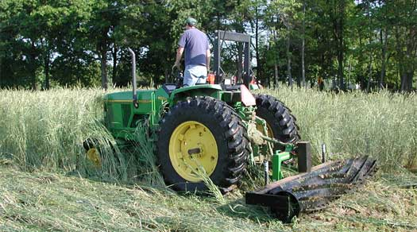
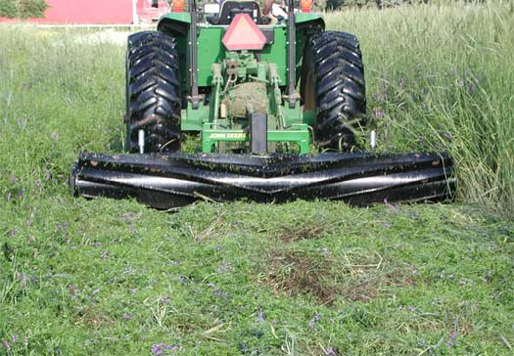
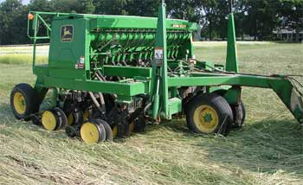
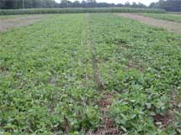
Organic Low/No Till Climate Smart Agriculture without Herbicides
Pictures: Rodale Institute

Slide 37
High Yields and Low Energy in Organic Agriculture without Herbicides
Yield
The 2006 trails resulted in organic yields of 160 bushels an acre (bu/ac)
Compared to the County average of 130 bu/ac.
Energy Used in Different Corn Production Systems Expressed in Litres of Diesel per Hectare
Conventional Tillage: 231 litres per hectare
Conventional No-till: 199 litres per hectare
Organic Tillage: 121 litres per hectare
Organic No-till: 77 litres per hectare
(Pimentel et al. 2005) gallon per acre = liters per hectare (close enough)

Slide 38
High Yield Regenerative Organic Agriculture
A report by the United National Conference on Trade and Development (UNCTAD) and the United Nations Environment Programme (UNEP) stated on Organic Agriculture:
114 projects in 24 African Countries covering 2 million hectares and 1.9 million farmers
‘…the average crop yield was … 116 per cent increase for all African projects and 128 per cent increase for the projects in East Africa.’
Organic Agriculture and Food Security in Africa 2008
80% of the food consumed in the developing world comes from small (5 acres or less) family farmers (FAO)
The vast majority of the world’s food insecure people live in the developing world (FAO)

Slide 39
High Yield Regenerative Organic Agriculture
Organic yield 2.7 times more per ha than conventional farms in developing countries; (Badgley et al., 2007)
Small farms are 2 to 4 times more energy efficient than large conventional farms. (Chapell and Lavalle, 2009)
Notes:
;

Slide 40
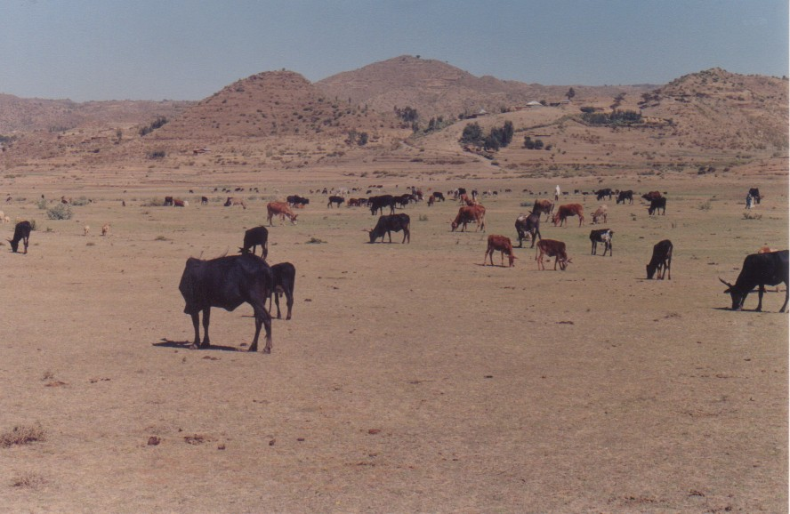
High over-grazing and burning = Deep, wide and long erosion gullies Low soil organic matter = Low soil fertility Serious food insecurity in dry years Thousands died in famines
Tigray, Ethiopia

Slide 41
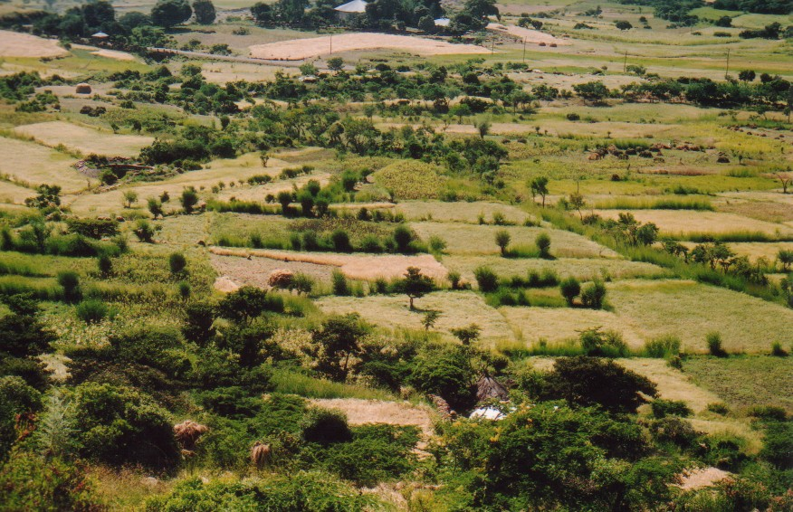
Adi Nefas, Tigray, Ethiopia - Agroecology
Pond
Rehabilitated gullies
Faba bean
Sesbania trees and long grasses
Rehabilitated biodiverse hillside
Composted fields growing tef, wheat and barley

Slide 42
Impact of using compost - Grain yields from over 900 samples from farmers fields over 7 years
Notes:
The farmers use their own varieties (landraces)

Slide 43
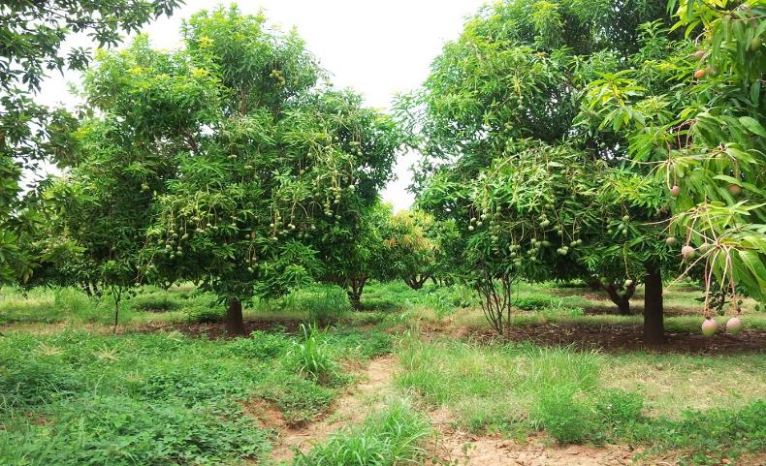
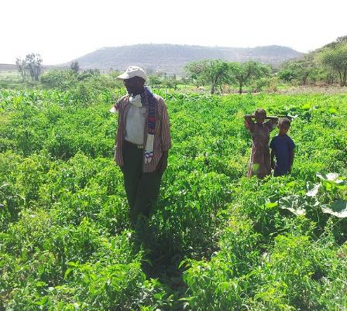
Intercropping to fix N for free Desmodium repels pests, suppresses weeds (selective allelopathy), provides fodder Alfalfa hosts beneficial insects Napier grass traps pests
Push-Pull Adapted to New Crops
Push Pull and insectaries in a mango orchard gives total pest control
Chilies grown with desmodium and alfalfa

Slide 44
Conclusion
Organic farming can increase food security by increasing water capture, resilience and yields in the uncertain weather extremes of climate change
We need more science to help improve and scale up OA.

Slide 45
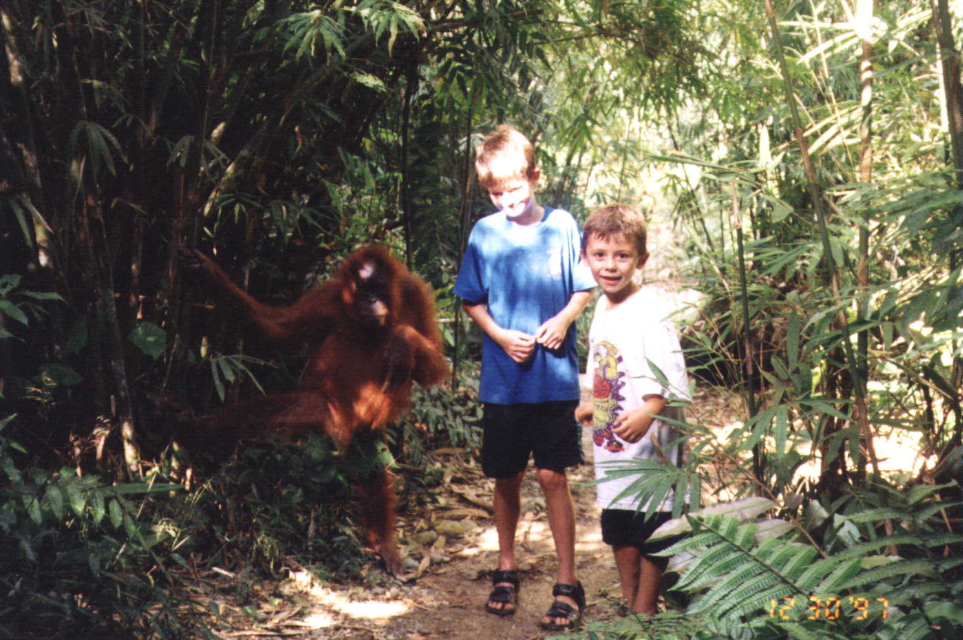
Thank You

